Slide 1

Optimization Algorithms
Mini-batch
gradient descent
deeplearning.ai

Slide 2
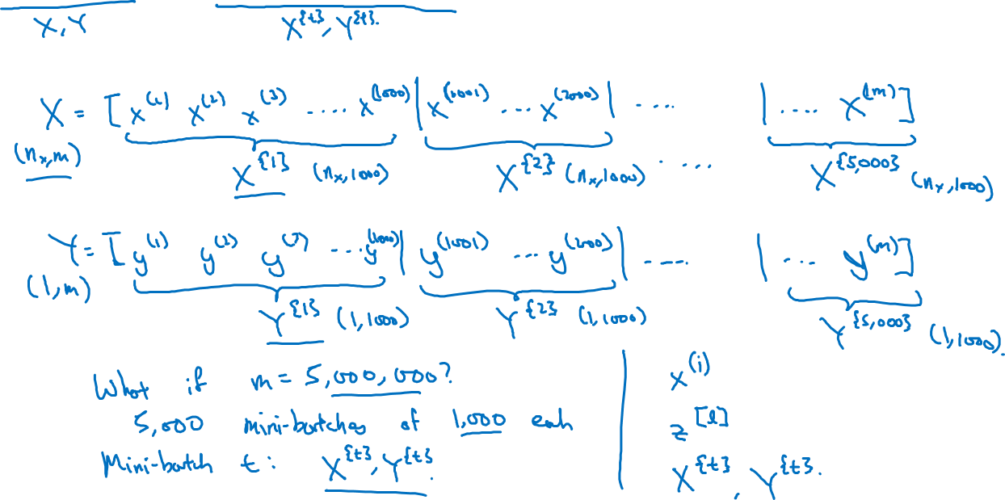
Batch vs. mini-batch gradient descent
Vectorization allows you to efficiently compute on m examples.

Slide 3
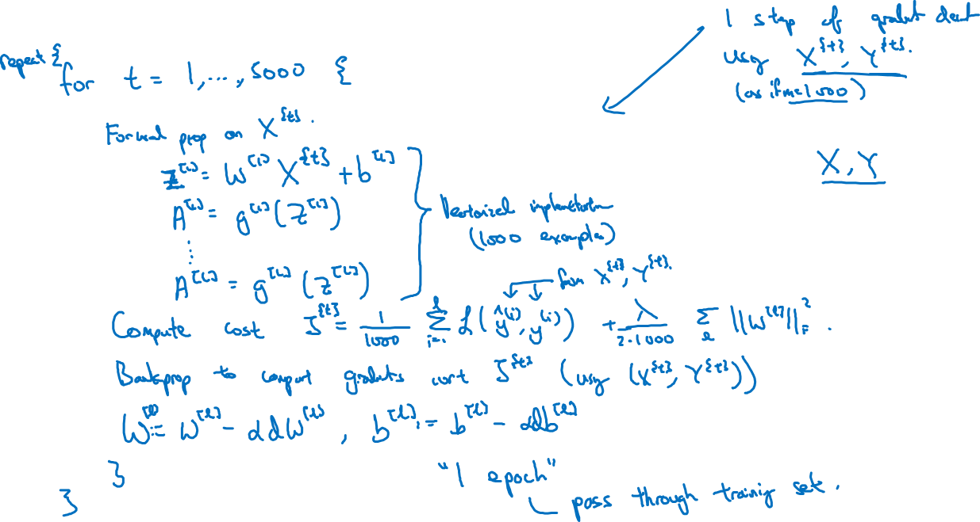
Mini-batch gradient descent

Slide 4
Optimization Algorithms
Understanding
mini-batch
gradient descent
deeplearning.ai

Slide 5
Training with mini batch gradient descent
Batch gradient descent
Mini-batch gradient descent
cost
cost
# iterations
mini batch # (t)

Slide 6
Choosing your mini-batch size

Slide 7
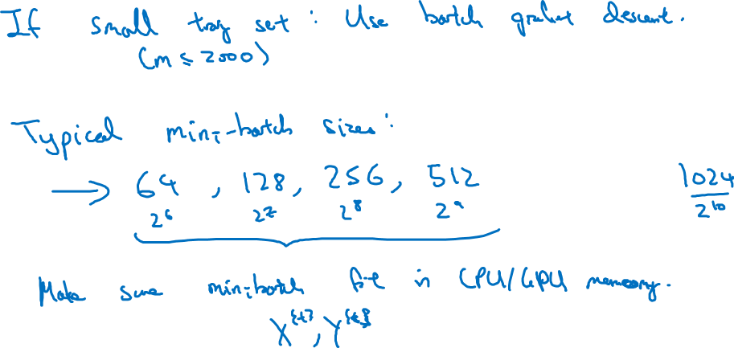
Choosing your mini-batch size

Slide 8
Optimization Algorithms
Exponentially weighted averages
deeplearning.ai

Slide 9
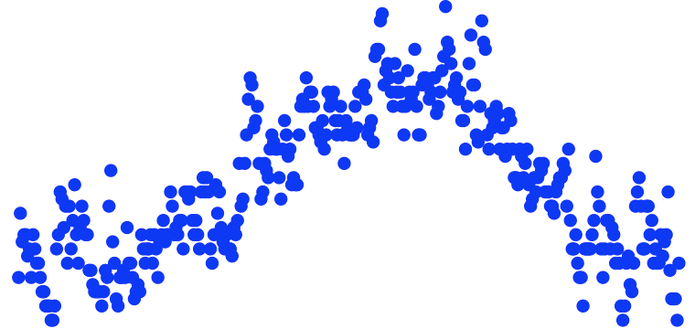
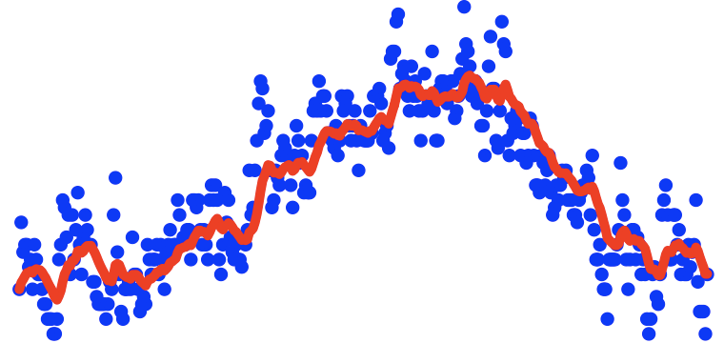
Temperature in London
$$θ_{1}=40°F$$
$$θ_{2}=49°F$$
$$θ_{3}=45°F$$
temperature
.
.
.
$$θ_{180}=60°F$$
$$θ_{181}=56°F$$
days
.
.
.

Slide 10
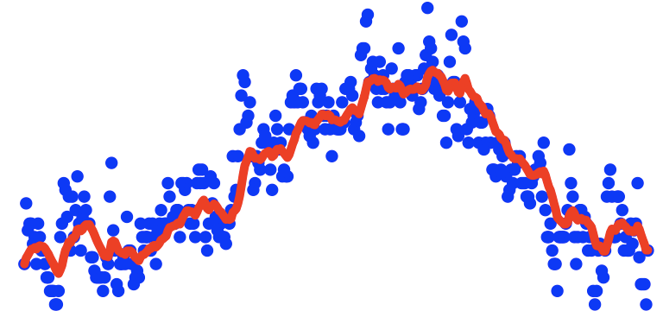
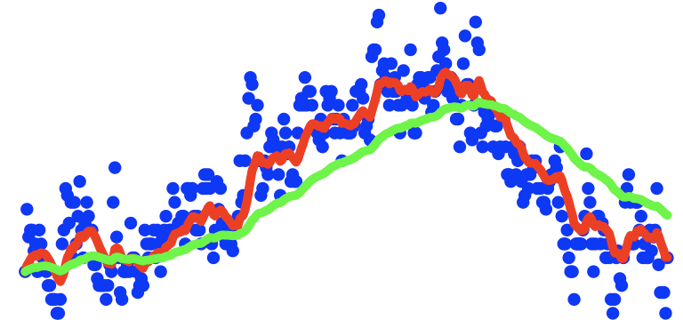
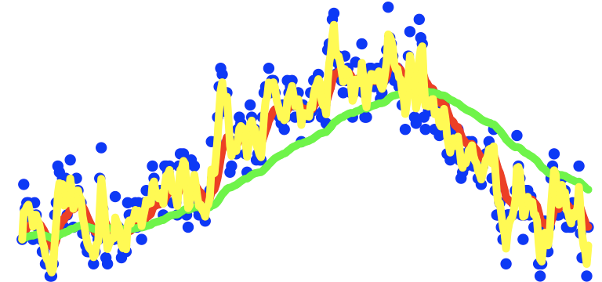
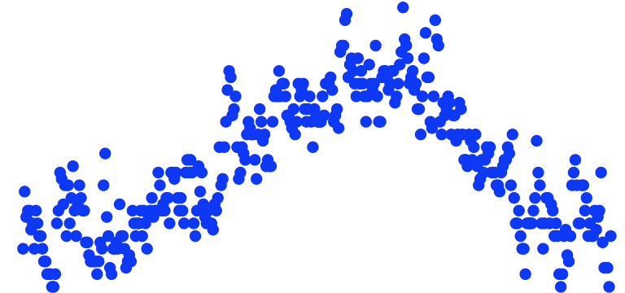
Exponentially weighted averages
temperature
days

Slide 11
Optimization Algorithms
Understanding exponentially weighted averages
deeplearning.ai

Slide 12
Exponentially weighted averages
$$v_{t}=βv_{t−1}+(1−β)θ_{t}$$
temperature
days

Slide 13
Exponentially weighted averages
$$v_{t}=βv_{t−1}+(1−β)θ_{t}$$
$$v_{100}=0.9v_{99}+0.1θ_{100}$$
$$v_{99}=0.9v_{98}+0.1θ_{99}$$
$$v_{98}=0.9v_{97}+0.1θ_{98}$$
$$…$$

Slide 14
Implementing exponentially weighted averages
$$v_{0}=0$$
$$v_{1}=βv_{0}+(1−β) θ_{1}$$
$$v_{2}=βv_{1}+(1−β) θ_{2}$$
$$v_{3}=βv_{2}+(1−β) θ_{3}$$
$$…$$

Slide 15
Optimization Algorithms
Bias correction
in exponentially
weighted average
deeplearning.ai

Slide 16
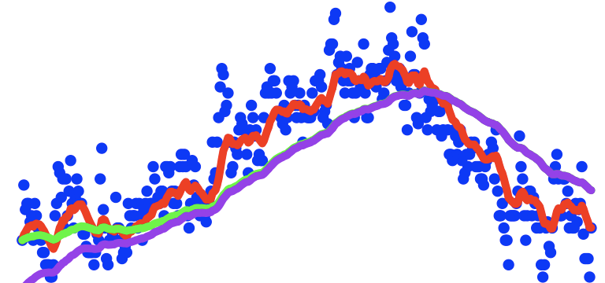
Bias correction
temperature
days
$$v_{t}=βv_{t−1}+(1−β)θ_{t}$$

Slide 17
Optimization Algorithms
Gradient descent with momentum
deeplearning.ai

Slide 18
Gradient descent example

Slide 19
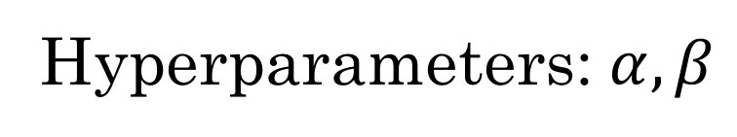



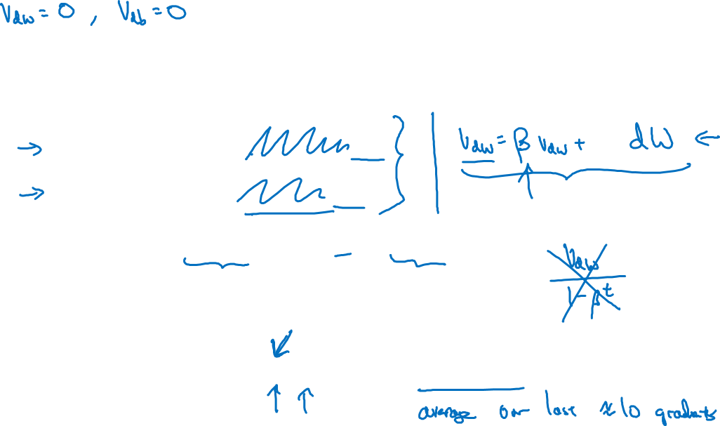

Implementation details
$$On iteration t:$$
Compute $dW,db$on the current mini-batch
$$v_{dW}=βv_{dW}+\left(1−β\right)dW$$
$$v_{db}=βv_{db}+\left(1−β\right)db$$
$$W=W−αv_{dW},$$
$$b=b−αv_{db}$$
Hyperparameters: $α,β$
$$β=0.9$$

Slide 20
Optimization Algorithms
RMSprop
deeplearning.ai

Slide 21
RMSprop

Slide 22
Optimization Algorithms
Adam optimization
algorithm
deeplearning.ai

Slide 23
Adam optimization algorithm
yhat = np.array([.9, 0.2, 0.1, .4, .9])

Slide 24

Hyperparameters choice:
Adam Coates

Slide 25
Optimization Algorithms
Learning rate
decay
deeplearning.ai

Slide 26
Learning rate decay

Slide 27
Learning rate decay

Slide 28
Other learning rate decay methods

